Slide 1


Montana Department of Transportation
Intern Onboarding- Filling out New-Hire Paperwork

Slide 2
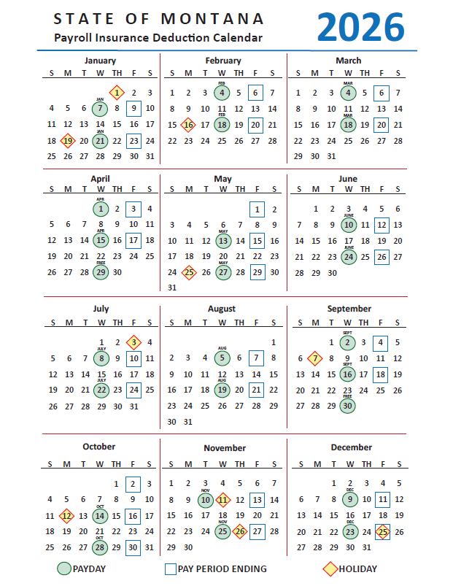
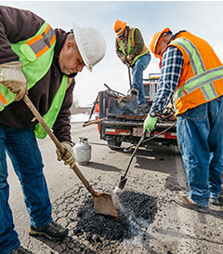


Slide 3
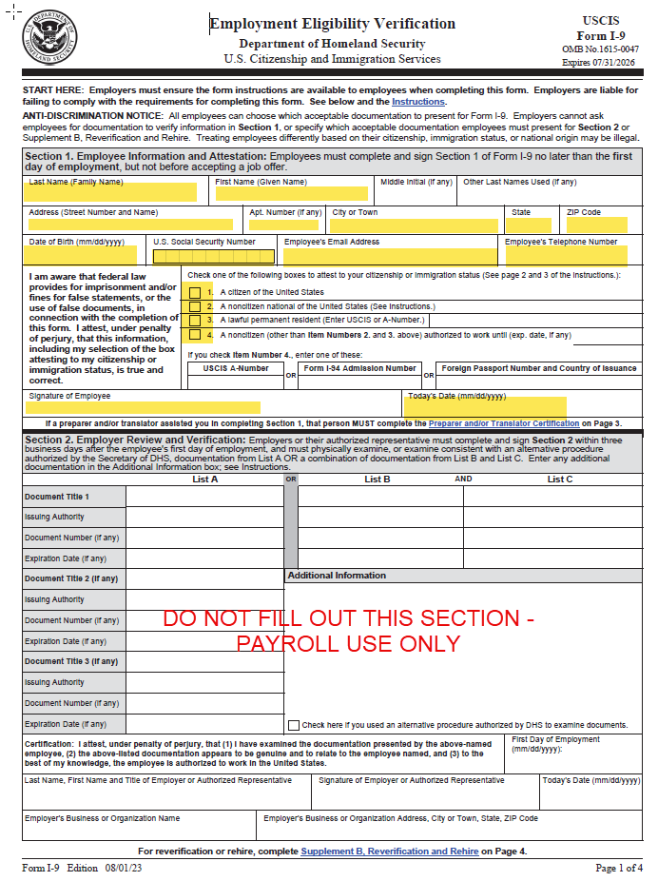


Slide 4
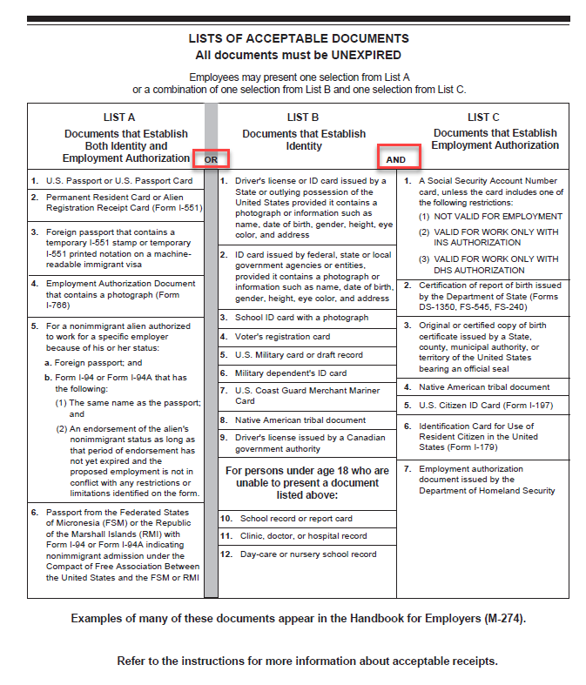


Please bring your I-9 Documents with you on your first day at MDT. Choose one document from List A OR one document from List B and one document from List C.
Documents must be verified within 72 hours of an employees hire date or they may not return to work until documents are provided and verified.

Slide 5
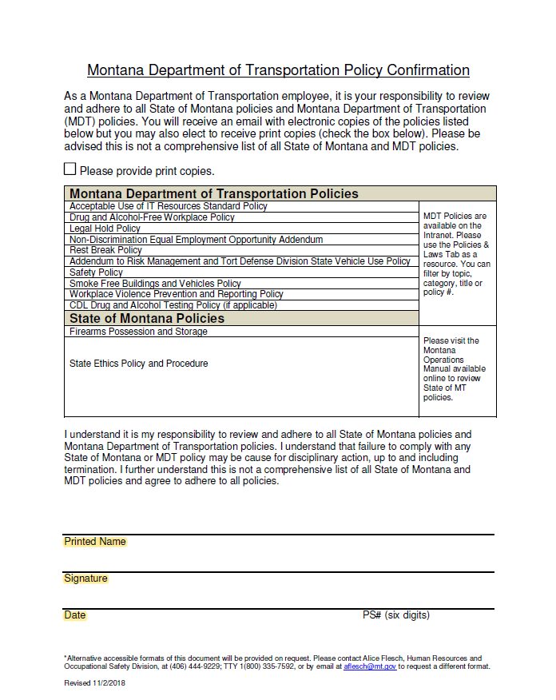


Slide 6
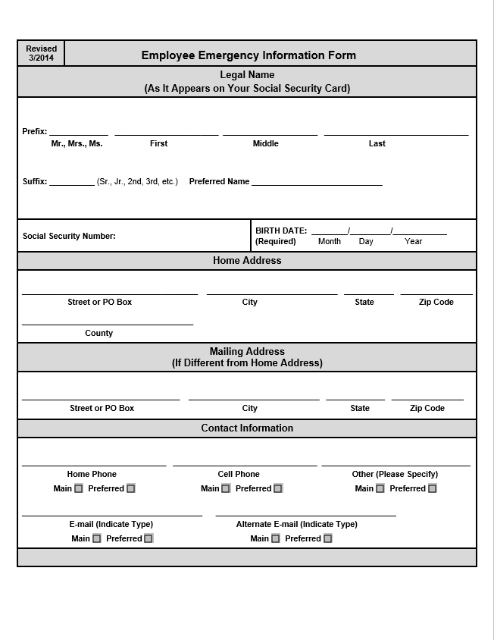
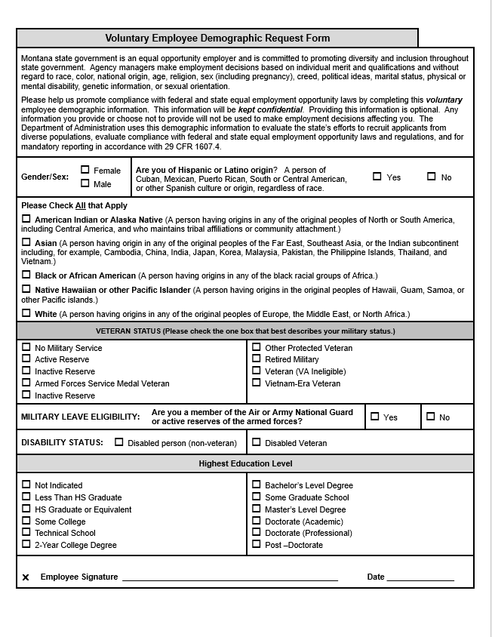

Slide 7
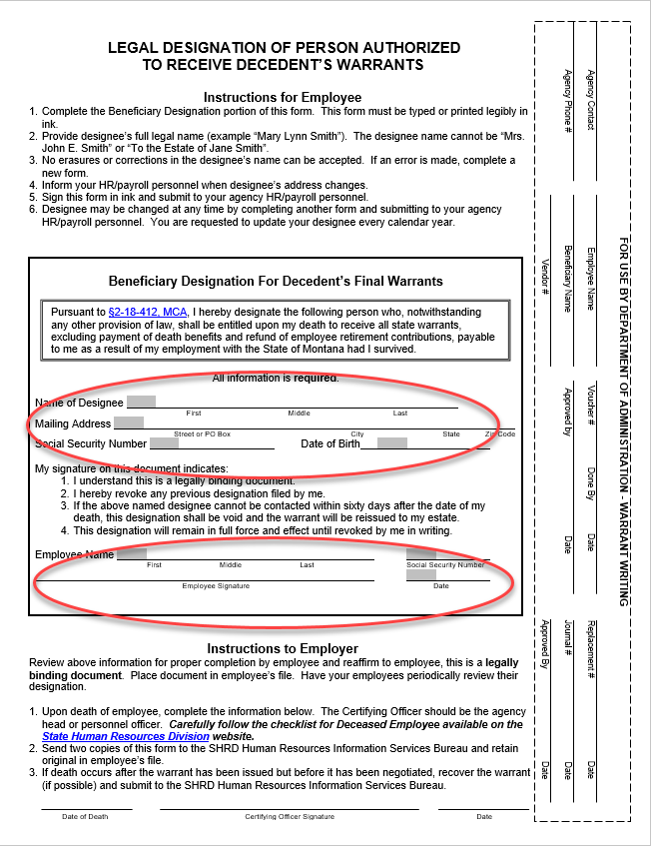
Note: Name of Designee cannot be yourself

Slide 8
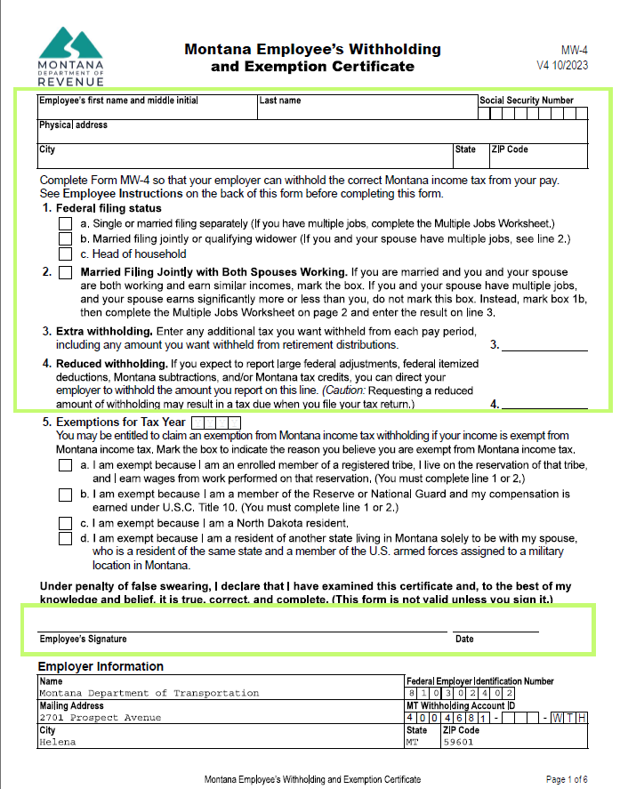
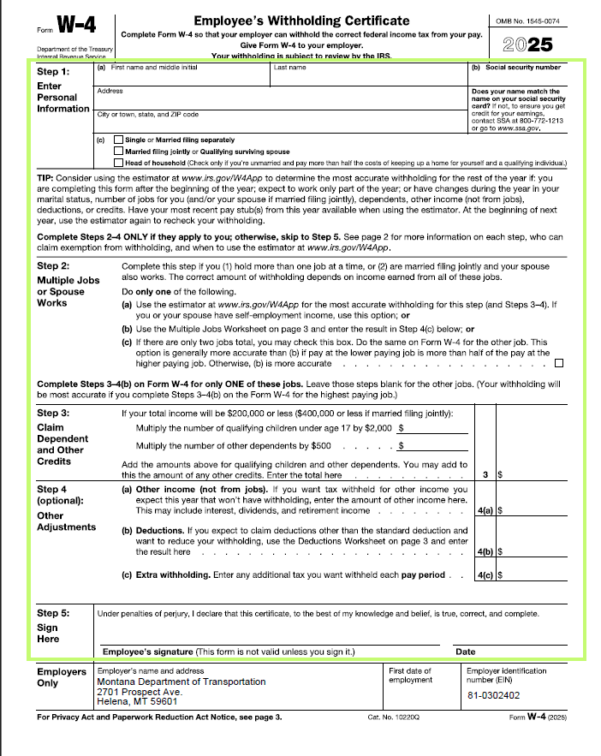

Please refer to IRS.GOV with questions.

Slide 9
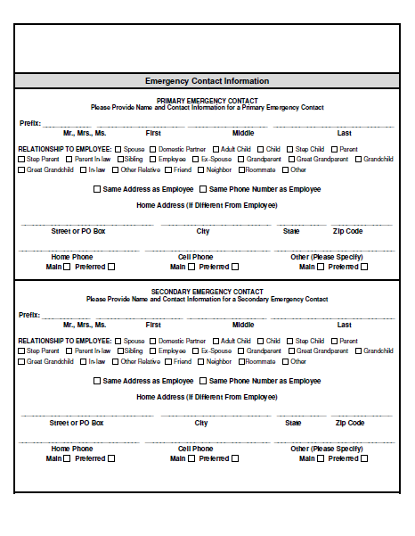
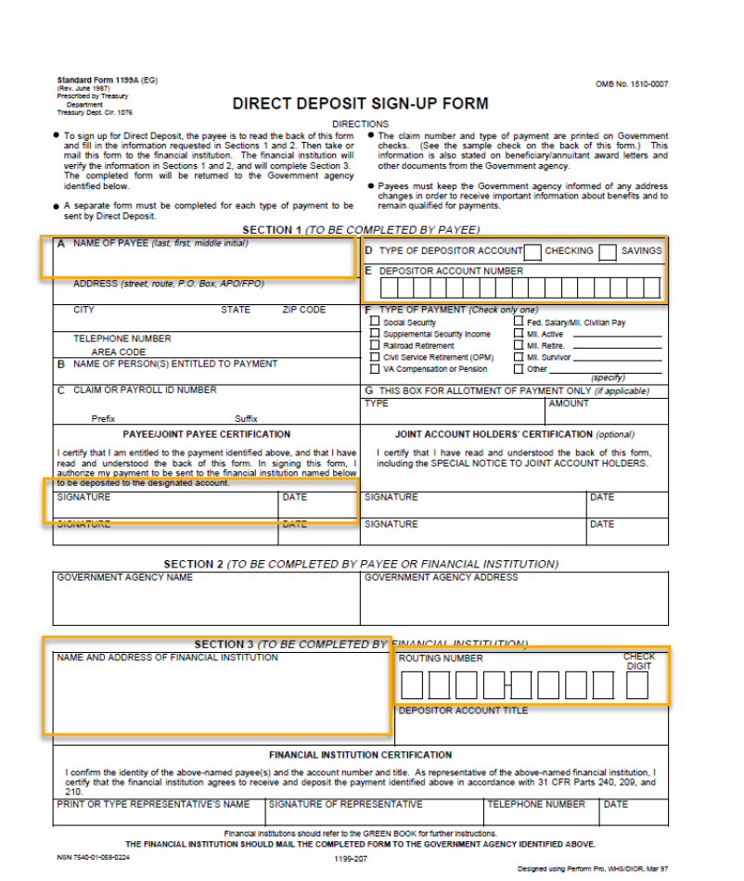

Slide 10
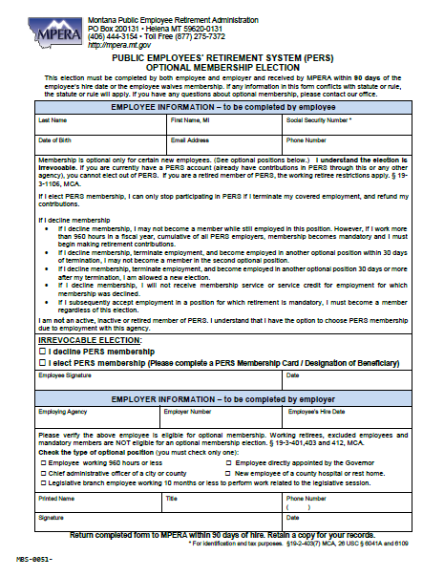
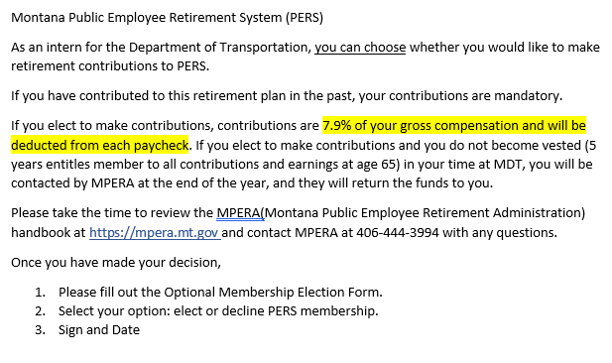

Slide 11
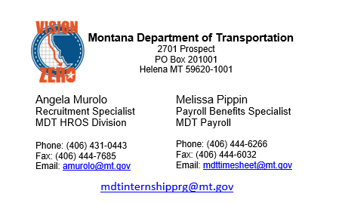
Please do not hesitate to reach out to Angela Murolo for HR/Internship questions or Melissa Pippin for Payroll questions. We look forward to meeting you on your first day with MDT!

