Slide 1
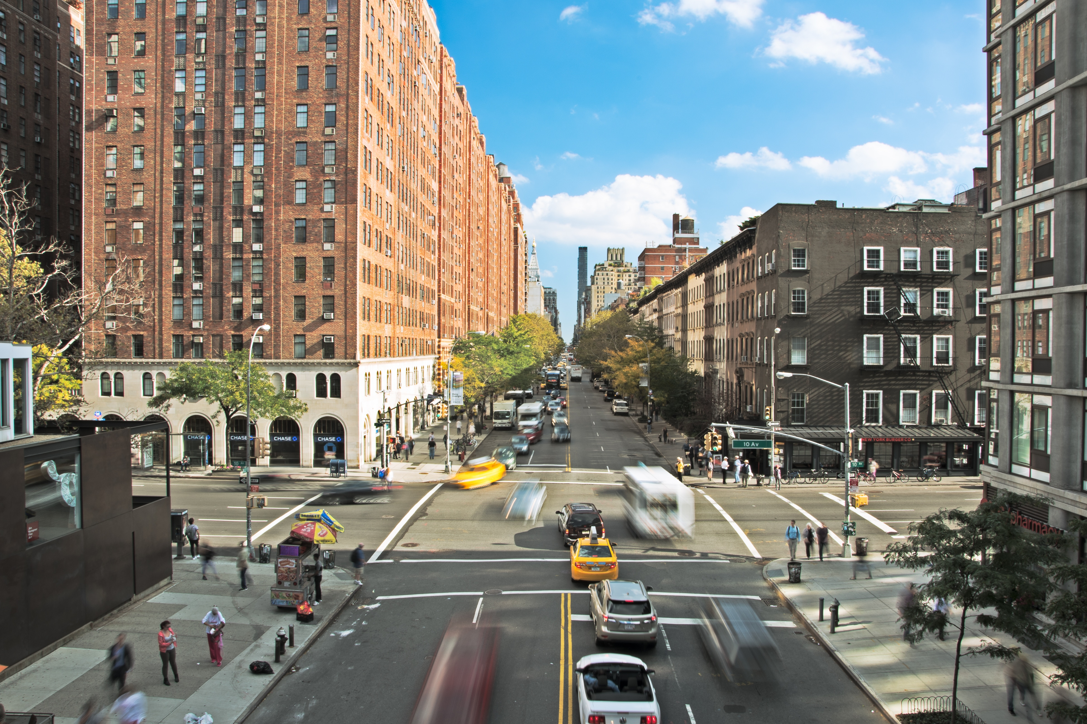
^{Traffic Safety}
^{Culture:}
A primer for traffic safety practitioners

Slide 2
Vision
“A zero deaths vision requires a change—a shift in culture both within transportation agencies and other organizations as well as within communities. Everyone must accept that fatalities are unacceptable and preventable.”
https://safety.fhwa.dot.gov/zerodeaths

Slide 3
Background
Traffic safety is important to us all.
We must set a target of zero traffic fatalities.
We will not achieve a target of zero using only traditional strategies.
We must also create a “Traffic Safety Culture” that encourages safe road user behavior and effective partnerships among stakeholders.

Slide 4
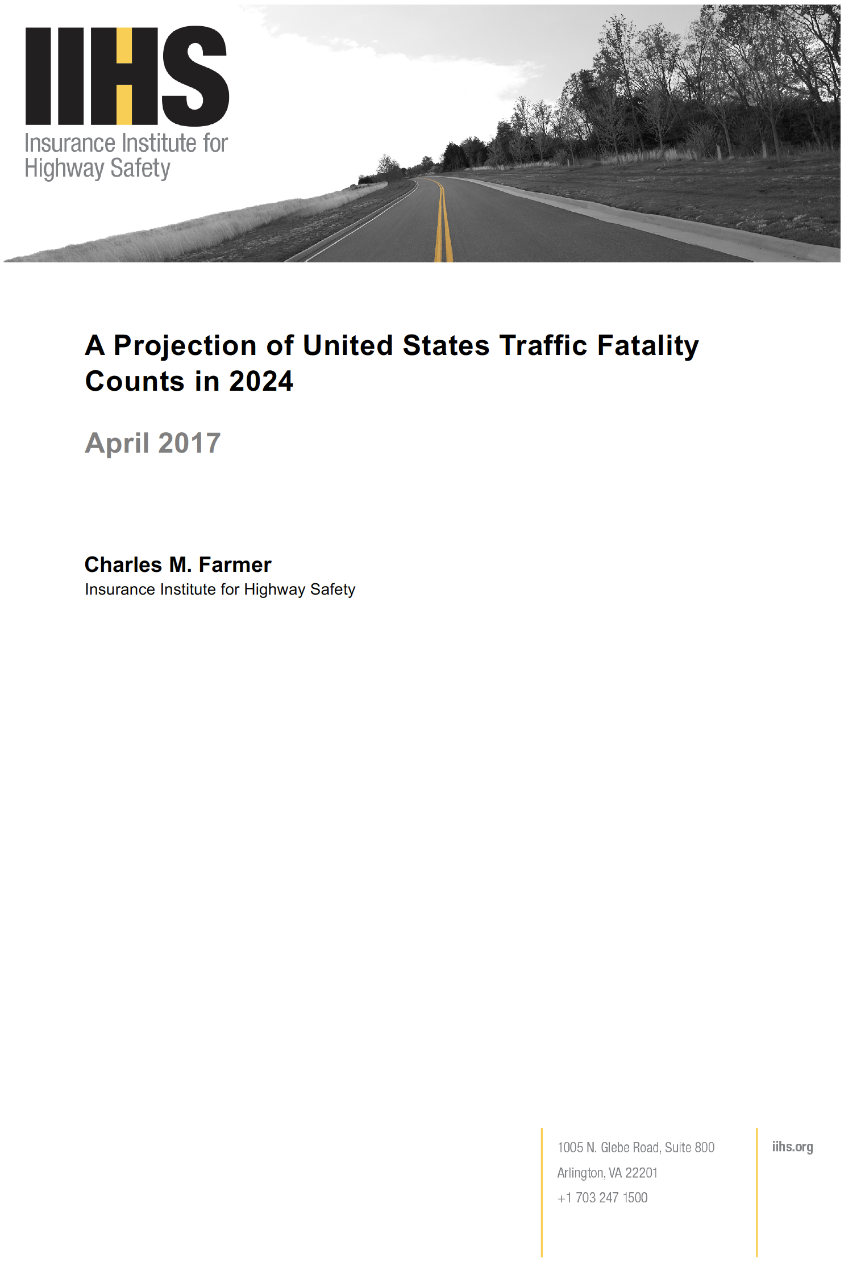
Traffic Safety
The number of traffic fatalities increased from 2014 to 2016.
Current predictions estimate 33,000 fatalities in 2045.
Greater reductions are needed to reach a target of zero.
This will require exploration of new and innovative strategies.
www.iihs.org/api/datastoredocument/bibliography/2137
Notes:
“Should the decline in deaths continue at the same rate beyond 2024 (0.2% per year), there would be approximately 33,000 deaths in the year 2045. This is considerably short of the goal of the NHTSA Road to Zero initiative. Thus, new strategies and expanded effort are needed to accelerate the decline in traffic deaths.”

Slide 5
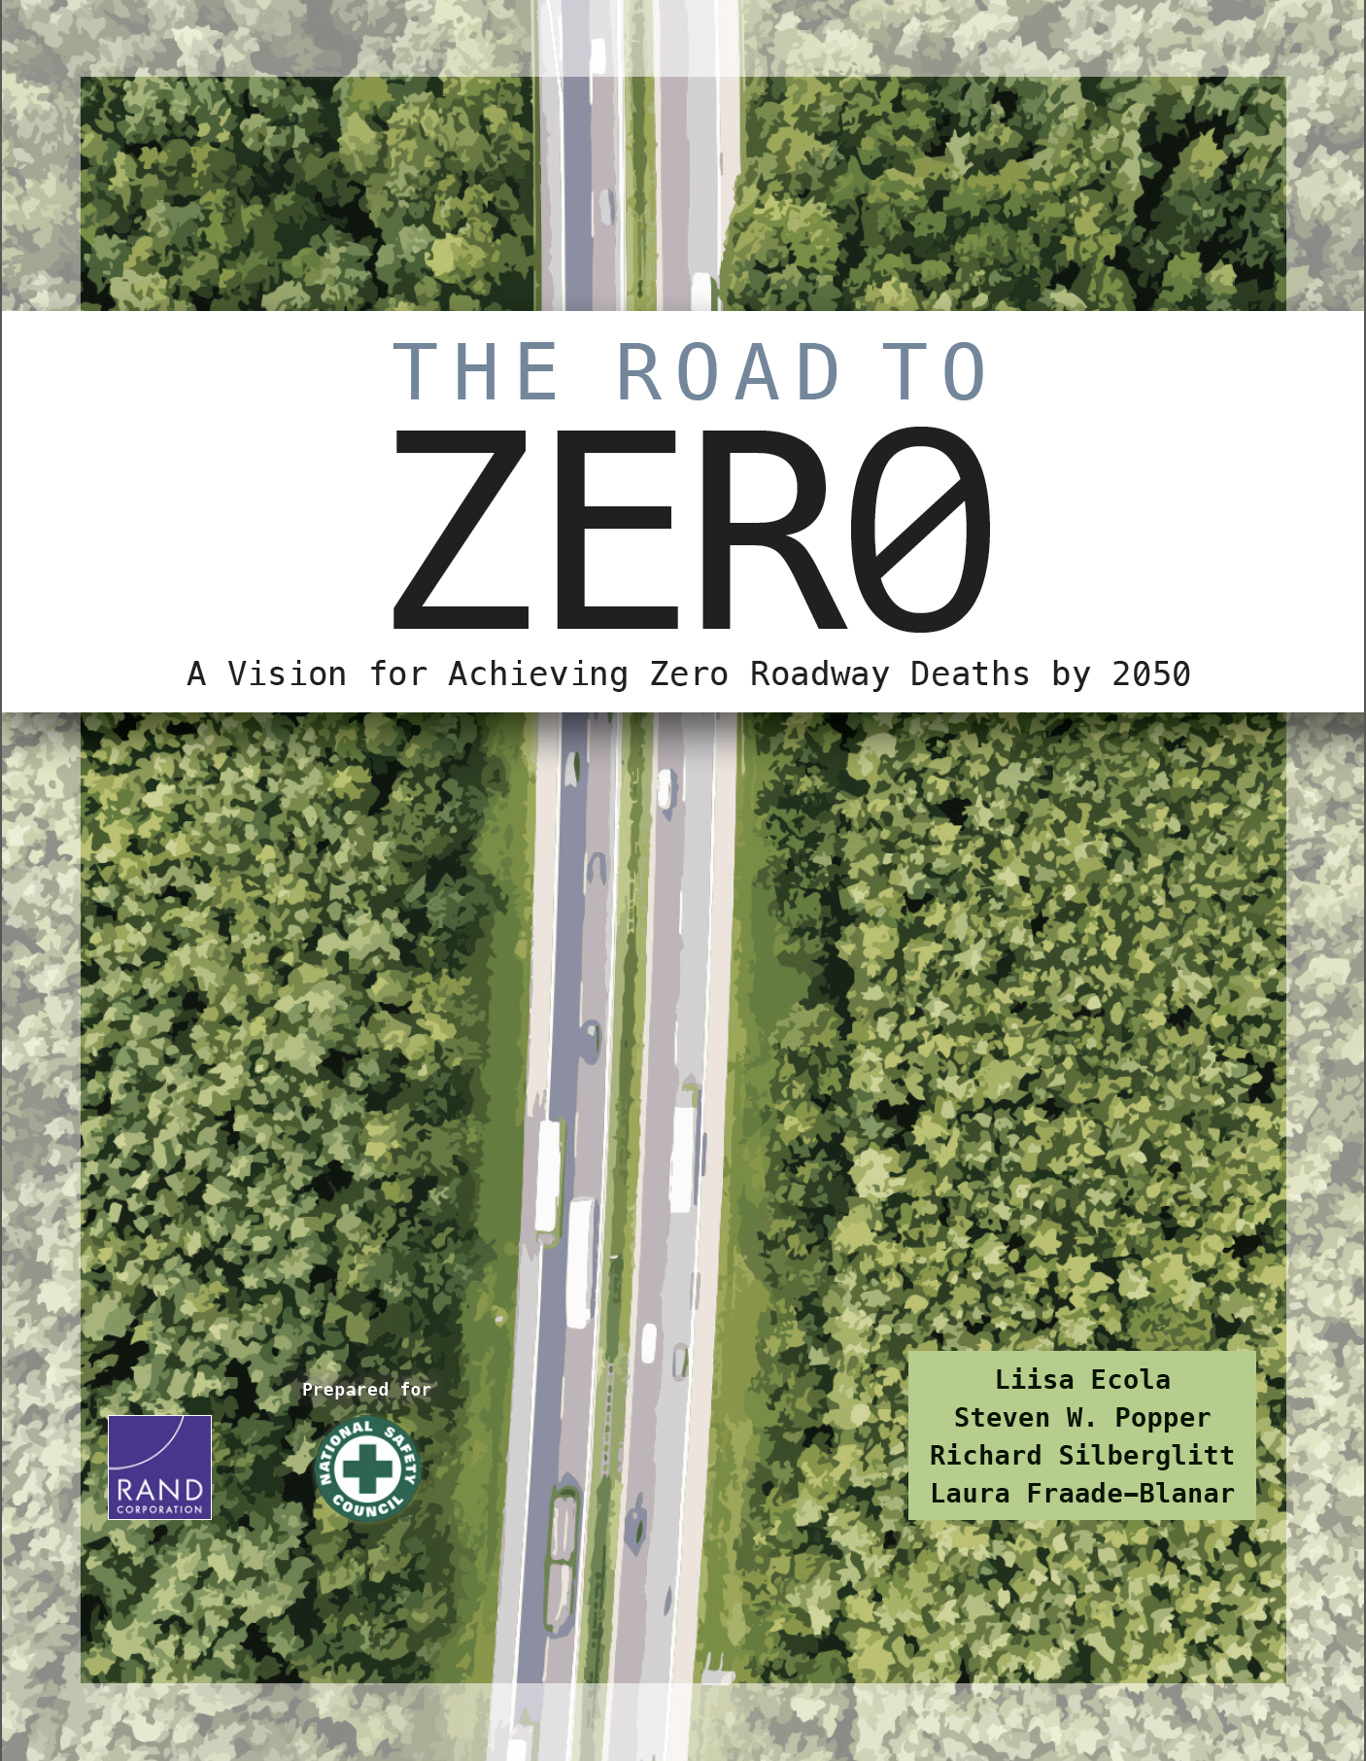
Strategies
The Road to Zero Coalition has concluded that three interdependent strategies are needed to reach zero:
  Double down on what works.
  Accelerate advanced technology.
  Prioritize safety.
“A pervasive safety culture is an essential ingredient for reaching zero roadway deaths.”
www.nsc.org/road-safety/get-involved/road-to-zero

Slide 6
Driver Behavior
Driver behavior is the most frequent “critical reason” for fatal crashes.
Driver behavior is often a deliberate choice.
Driver behavior can be changed to support safer choices.
https://crashstats.nhtsa.dot.gov/Api/Public/ViewPublication/812115

Slide 7
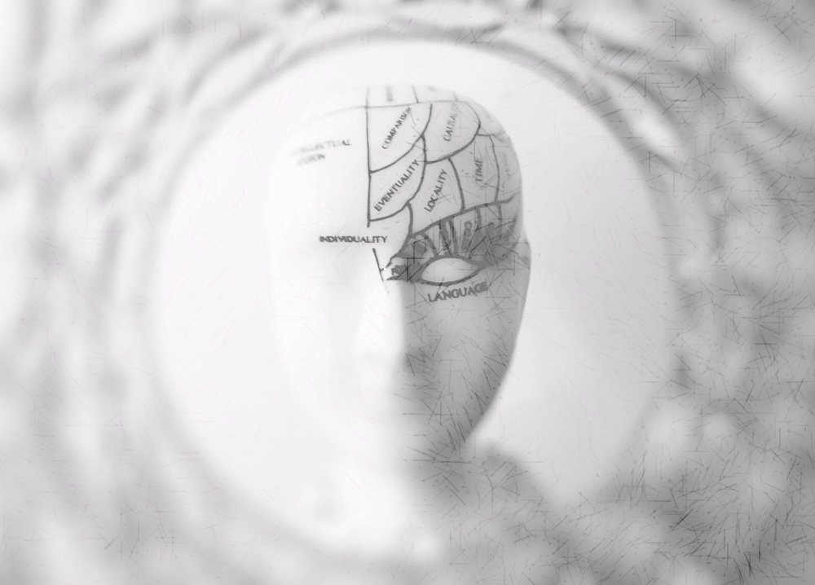
Beliefs
Our minds form “beliefs” from our experiences.
Beliefs determine our understanding of the world.
Beliefs influence our choices about behavior.
To change behavior, we must change beliefs.

Slide 8
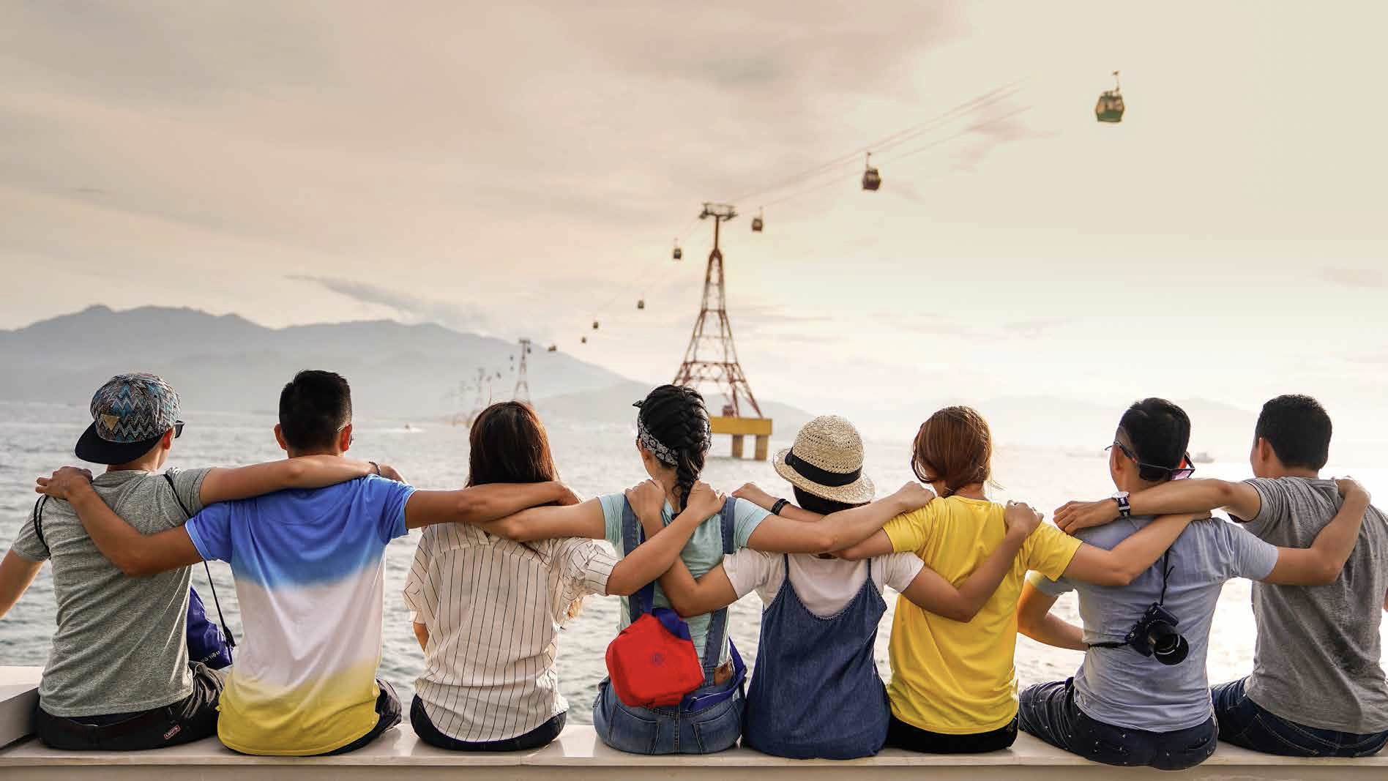
Relationship
Humans rely on social relationships.
We identify with many groups in our social environment.
To identify with a group, we share the belief system that defines the group “culture.”

Slide 9
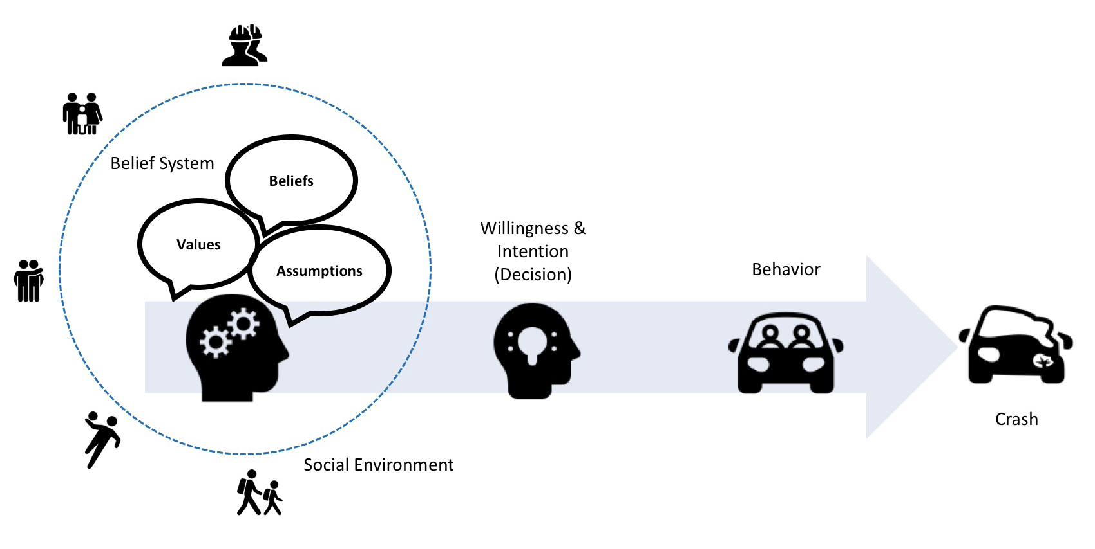
Traffic Safety Culture
“Traffic Safety Culture” is the shared belief system of a group of people that influences road user behaviors and stakeholder actions that impact traffic safety.

Slide 10
Road Users
Road users include all participants within the roadway system.
Road user behaviors can either increase crash risk (risky) or reduce crash risk (protective).
Our goal is to reduce road user risky behaviors and increase protective behaviors.
Notes:
Pexel

Slide 11
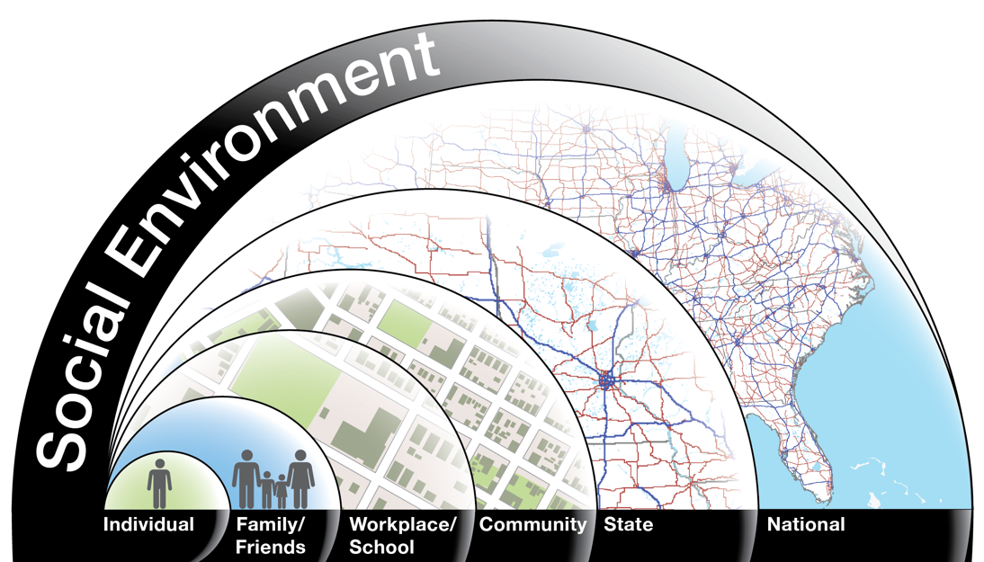
Stakeholders
There are many traffic safety stakeholders within our social environment.
Traffic Safety Culture also applies to actions taken by traffic safety stakeholders.
These stakeholders can take actions together to change road users beliefs.

Slide 12
Stakeholder Actions
Traditional
Non-Traditional
Create effective traffic laws.
Allocate resources to traffic safety programs.
Improving EMS response times.
Engaging new partners in promoting traffic safety.
Create family rules about always wearing a seat belt.
Schools promoting best-practices in driver education.
Workplaces developing training to achieve zero motor vehicle incidents.

Slide 13
Cultural “Lens”
Approaching traffic safety through the lens of traffic safety culture is different than traditional approaches in a number of important ways, making us more effective in achieving our vision zero target:
      Protective Behavior
      Proactive Behavior
      Effective Partnerships

Slide 14
A. Protective Behaviors
We recognize that traffic safety can be improved by growing beliefs that increase protective behaviors, rather than only focusing on beliefs to reduce risky behaviors.

Slide 15
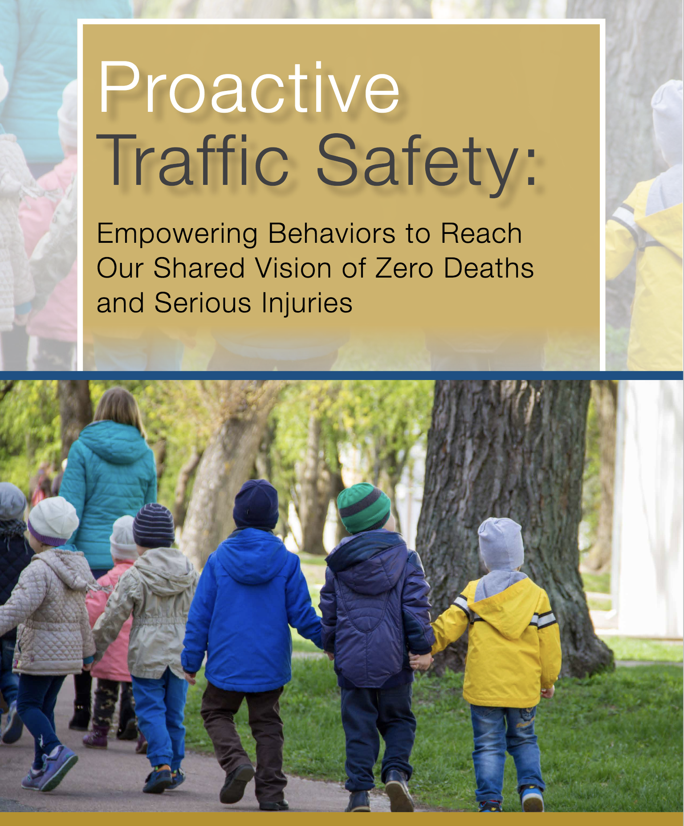
B. Proactive Behavior
A positive traffic safety culture not only encourages road users to choose safe behaviors, it also encourages them to be proactive by encouraging other road users to behave safely.

Slide 16
C. Effective Partnerships
Stakeholder | Example Action (Increase Seat Belt Use)
Families | Establish family rules about always wearing a seat belt
Schools | Include seat belt education in health class; promote asking friends to wear a seat belt
Workplaces | Establish and train on workplace seat belt policies
Law Enforcement | Model seat belt use by always wearing a seat belt Consistently enforce seat belt laws (not just during campaigns) Advocate for seat belt use in the community
A positive traffic safety culture also increases the capability of traffic safety stakeholders to form effective partnerships, resulting in the integration of strategies to form a safe system.

Slide 17
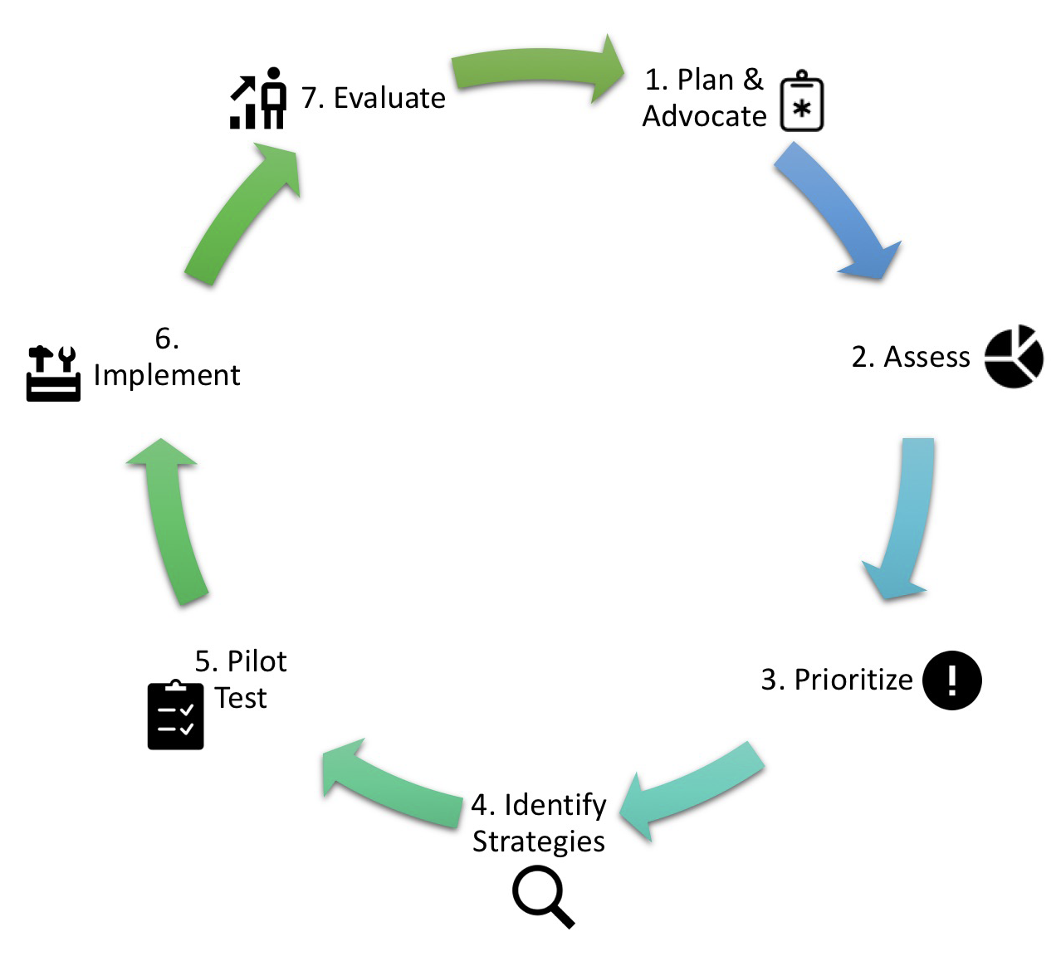
Process
Growing traffic safety culture is a process – not a single intervention or countermeasure.
A process describes generalized steps, a context for performing those steps, and skills required to be successful.

Slide 18
Next Steps
Topic Importance
How do traffic crashes and their consequences impact our community?
What is our responsibility in reducing crashes?
Challenge Beliefs
Are we being effective?
What might be some new ways to positively influence road user behavior?
Motivate Learning
How do you define traffic safety culture?
How do you know you are accurately perceiving your community’s traffic safety culture?
Creating a shared understanding about traffic safety culture.
Shared understanding comes from discussing questions that address important topics, challenge beliefs, and motivate learning.
Here are some example questions.

Slide 19
Next Steps
Internal Safety Procedures
How is safety of employees a top priority with management?
How do employees and management work together to ensure the safest possible working conditions?
External Safety Programs
Does everyone in our organization agree that no one should be killed or seriously injured while using our roadways?
Does everyone in our organization recognizes that achieving the goal of zero traffic fatalities and serious injuries will require a change in Traffic Safety Culture?
We must examine our own culture before trying to change the culture of others.
We will be neither effective nor authentic in our efforts to grow traffic safety culture in a community if our own agency’s culture is not safe.
Here are some example questions.

Slide 20
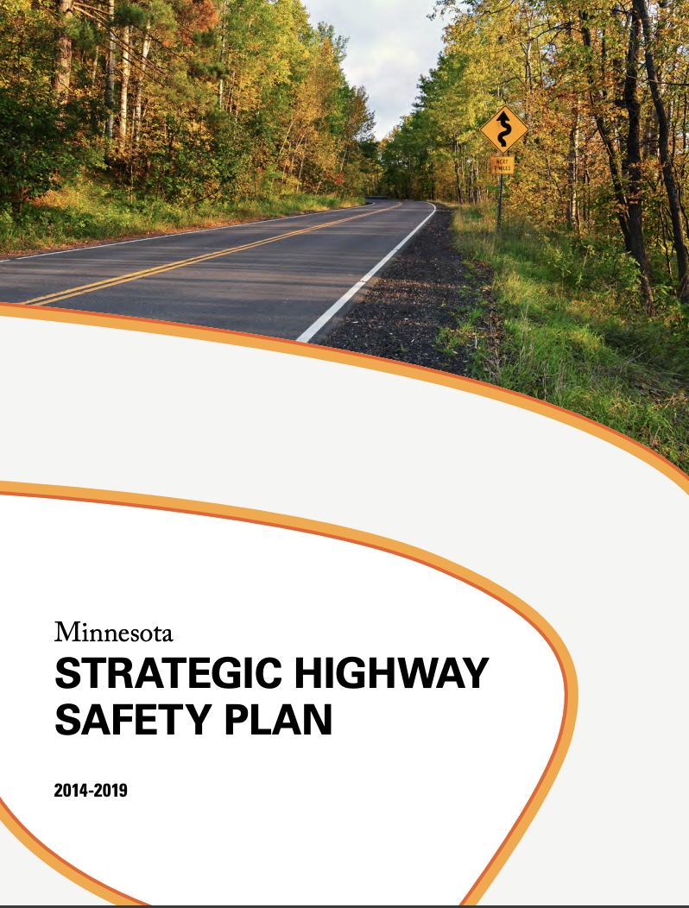
Next Steps
Finding opportunities to formally adopt traffic safety culture as an approach to traffic safety goals.
For example, MnDOT included traffic safety culture at the core of their Strategic Highway Safety Plan. This motivates attention to traffic safety culture and justifies resources to develop strategies to change it.
http://www.dot.state.mn.us/trafficeng/safety/shsp/Minnesota_SHSP_2014.pdf

Slide 21
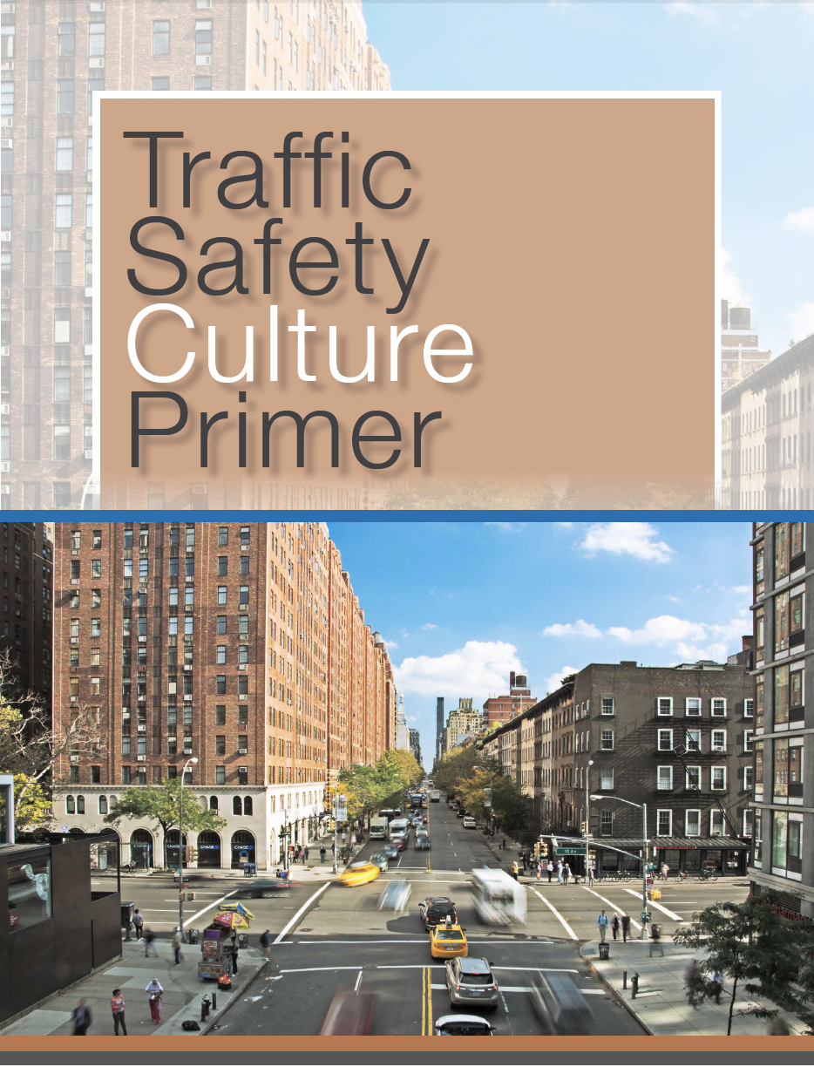
Find out more!
For more information, please access the Traffic Safety Culture Primer and its supporting tools:
https://www.mdt.mt.gov/research/projects/trafficsafety-primer.shtml
Developed by the Center for Health and Safety Culture
Montana State University
P.O. Box 170548, Bozeman,
MT 59717-0548
406-994-7873
mail@CHSCulture.org
This document is printed at state expense. Information on the cost of producing this publication may be obtained by contacting the Department of Administration. Alternative accessible formats of this document will be provided on request. Persons who need an alternative format should contact the Human Resources and Occupational Safety Division, Department of Transportation, 2701 Prospect Avenue, PO Box 201001, Helena, MT 59620. Telephone 406-444-9229. Those using a TTY may call 1(800)335-7592 or through the Montana Relay Service at 711.

