Slide 1
Virtual Public Meeting
October 14, 2020

Slide 2
MDT’S MISSION
“Through education, enforcement, engineering, and emergency medical response we’re moving toward zero deaths and injuries on Montana roadways.”
^{—Mike Tooley, Director}
LEARN MORE ABOUT VISION ZERO AT
^{www.mdt.mt.gov/visionzero}
MDT’s guiding mission is to serve the public by providing a transportation system and services that emphasize quality, safety, cost effectiveness, economic vitality, and sensitivity to the environment.

Slide 3
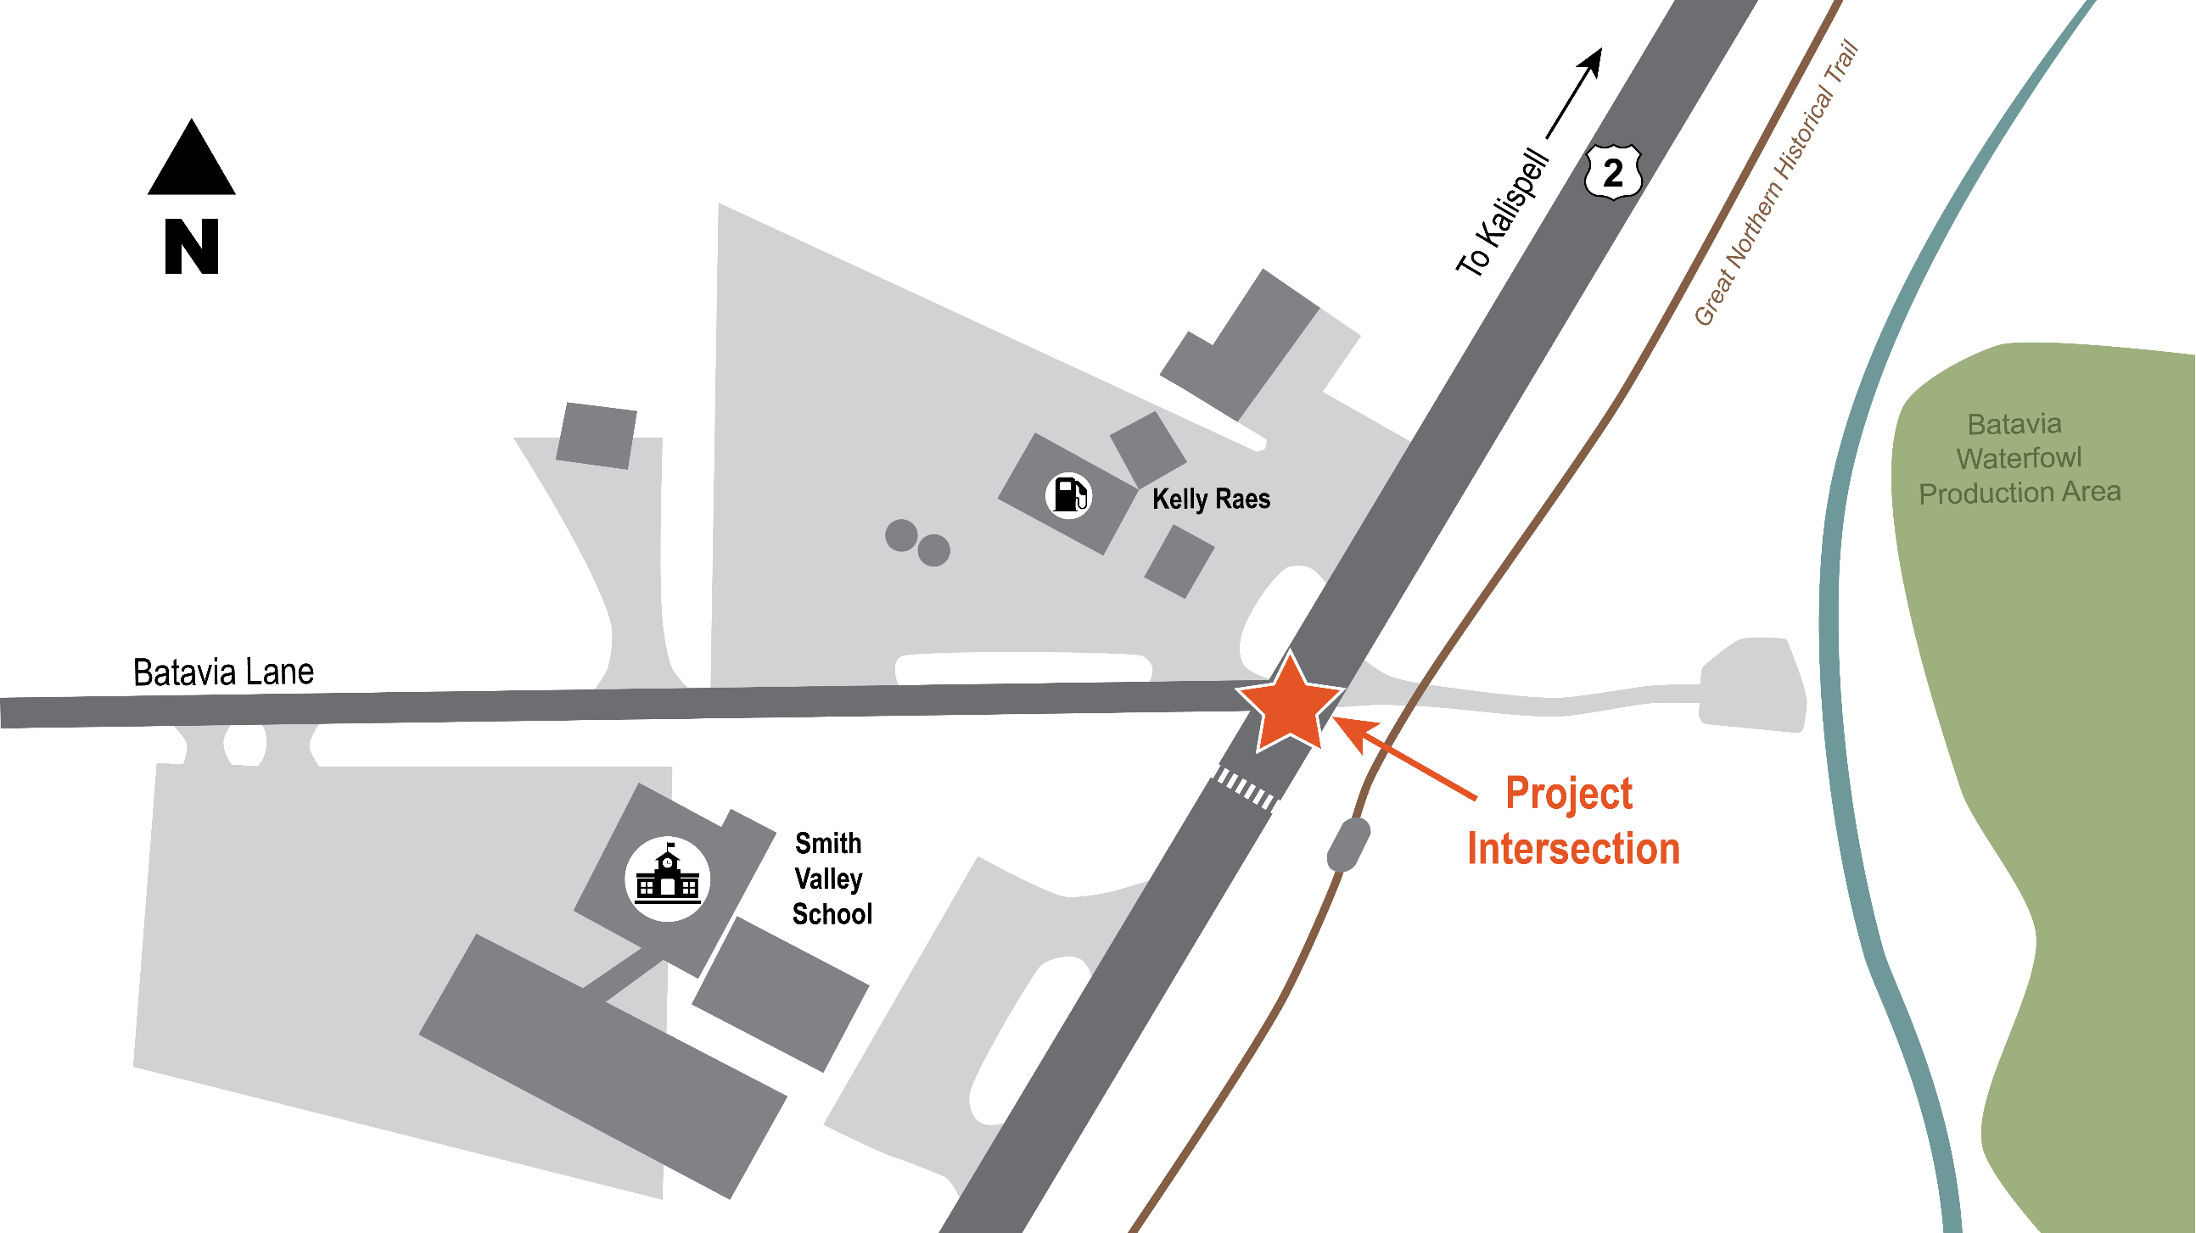

Slide 4
YOUR TOP PRIORITIES
Provide a Safe Crossing
Improve Left Turn from Batavia Lane to Hwy 2
Decrease Speeds
Improve Access and Circulation
Improve Visibility
Improve Right Turn from Hwy 2 to Batavia Lane
Improve Traffic Flow
Accommodate Large Trucks

Slide 5
ALTERNATIVES EVALUATION PROCESS
12 Alternatives
Alternatives Identification
All possible options
4 Alternatives
Tier I Evaluation
2 Alternatives
Tier II Evaluation
Identify feasible and reasonable options
Identify best performing options
SINGLE LANE ROUNDABOUT
TRAFFIC SIGNAL – Major Reconstruction and Raised Medians

Slide 6
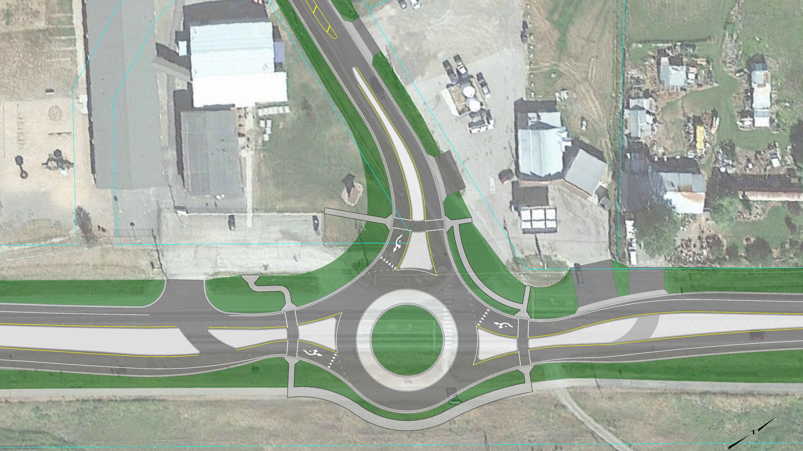
SINGLE LANE ROUNDABOUT
Configuration allows u-turns and improves circulation
Roundabout is designed to accommodate large trucks
Enhanced pedestrian crossing allows crossing one lane at a time
Raised medians reduce vehicle conflicts and controls access
Layout reduces vehicle speeds through the intersection
Roundabout improves intersection operations and reduces vehicle delay

Slide 7
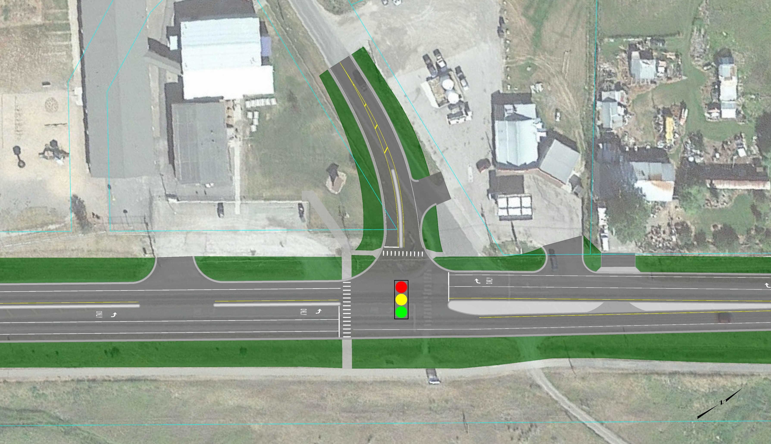
TRAFFIC SIGNAL – MAJOR RECONSTRUCTION AND RAISED MEDIANS
Intersection is realigned to improve visibility and definition
Driveways are modified to improve circulation and reduce conflict
Raised medians and curbing help to slow vehicles
Raised medians help to control access points and turning conflicts
Traffic signal provides better protection for crossing pedestrians
Traffic signal improves intersection operations and reduces vehicle delay

Slide 8
How Do The Alternatives Address Your Top Priorities?
SINGLE LANE ROUNDABOUT
TRAFFIC SIGNAL –
MAJOR RECONSTRUCTION AND RAISED MEDIANS

Slide 9
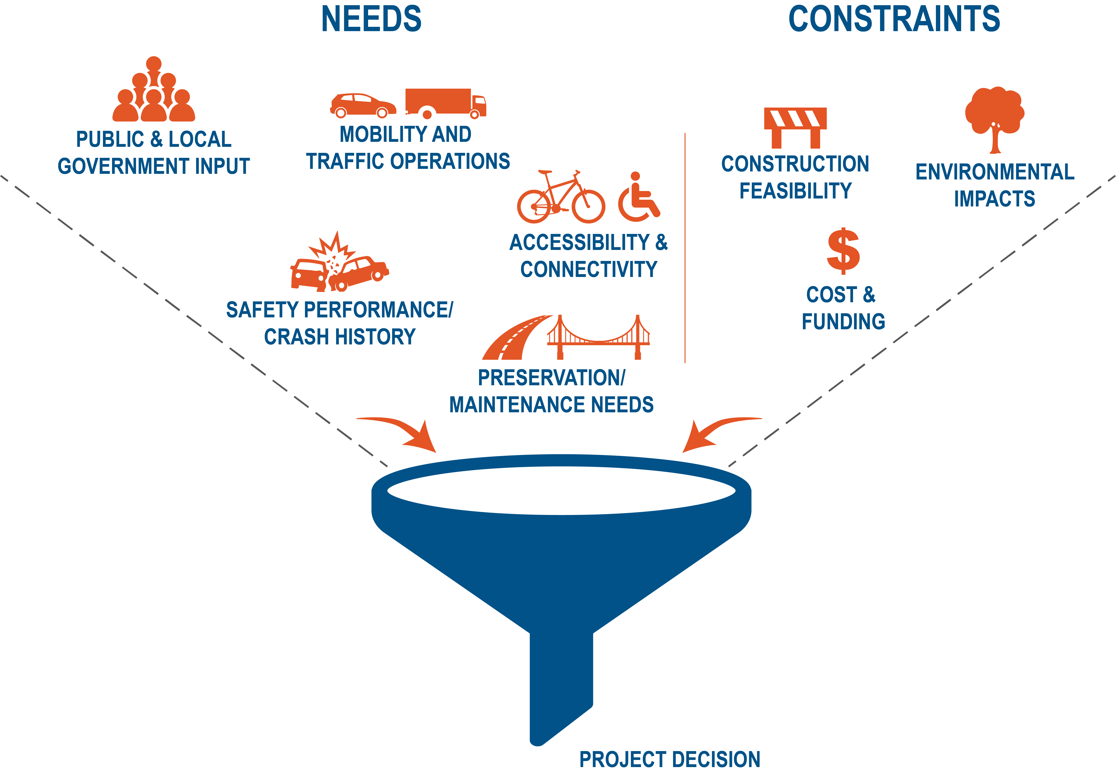
PROJECT DEVELOPMENT The final project decision will balance the needs against constraints to deliver the best improvement for this location.

Slide 10
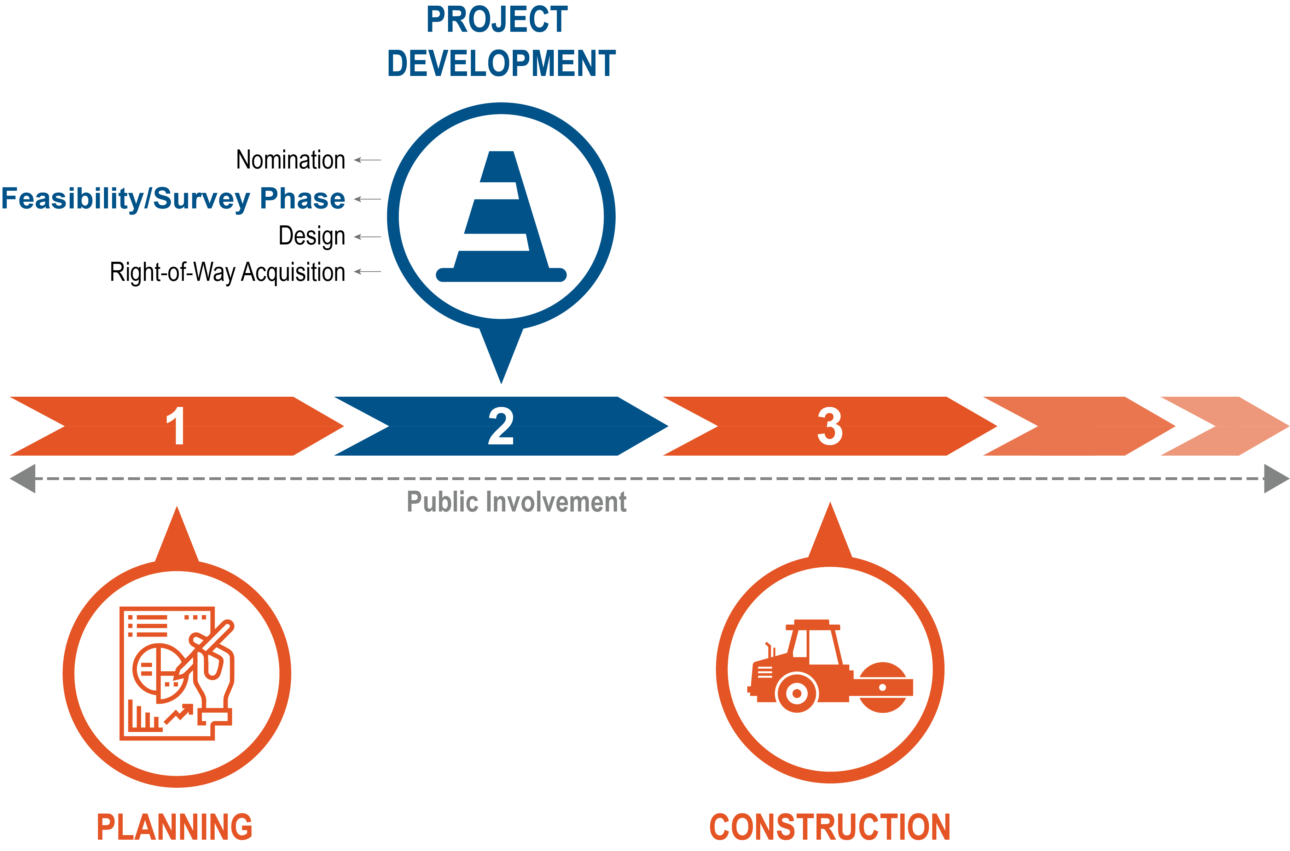
NEXT STEPS
Safe crossing (RRFB)
Design
Construction

Slide 11
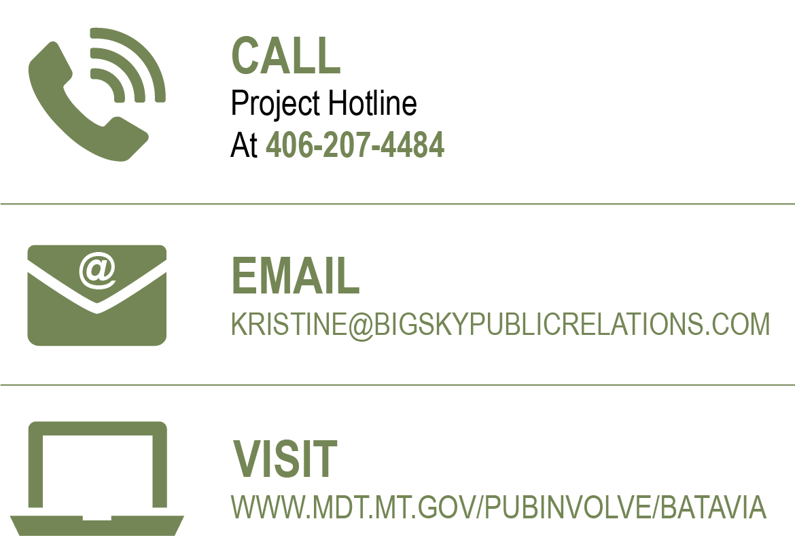
STAY IN THE KNOW

