Slide 1
Tim Burrows, Kimley-Horn
2025 Annual Transportation Safety Meeting
Helena, Montana
Safe Speeds/Safe Vehicles
Breakout Sessions
August 13-14, 2025
Notes:
Mike Colety

Slide 2





Safe Speeds &
Safe Vehicles
Emphasis Area – Data Analysis Overview: Safe Speeds & Safe Vehicles
Speed Related
Erratic/Reckless/
Negligent/Aggressive
Emerging Technologies
Large Vehicle

Slide 3
Safe Speeds / Safe Vehicles
Emergency Response – Post-Crash Care Discussion Team Leads
Breakout Group Facilitator
  Tim Burrows, Kimley-Horn
Breakout Group Subject Matter Experts
  Captain Doug Samuelson, MHP
  Major Chris Williams, Motor Carrier Services MDT
  Mike Warren, Maintenance MDT
  Mike Poole, Motor Carrier Services MDT
  Justin Ulmen, Occupational Safety & Health MDT
  Kaci Johnson, Motor Carrier Services MDT
  Russ Christoferson, Motor Carrier Services MDT
  Anna Mhoon, MT Motor Vehicle Division Department
  of Justice
Notes:
Note - sounds like Anna Moon

Slide 4
Strategy Break-Out Sessions
Annual Meeting - Strategy Break-Out Sessions
Data driven problem identification
Review of current best practices and proven strategies
Discussion of potential strategies
Group discussion on strategies for Montana
Notes:
Potential Strategies includes - Prior Montana, Neighboring State and National

Slide 5
Safe Speeds/Safe Vehicles:
Fatalities & Serious Injuries
Safe Speeds/Safe Vehicles: Fatalities & Serious Injuries (FSI)
*Please note that the figure percentages and numbers above may not sum up to the yearly total for the FSI. This discrepancy results from overlaps among existing sub-emphasis areas within each primary emphasis area.
Source: MDT 2014-2023 Crash Data, February 2025 Extract (Persons)
*Data current as of February 2025 and subject to change with subsequent updates.
Notes:
This slide is okay as long as Tim plans to connect the dots with MHP and Motor Services around the large vehicle involved discussions.

Slide 6
Speed Related Fatalities &
Serious Injuries (FSI)
Safe Speeds & Safe Vehicles: Speed Related Fatalities & Serious Injuries
Involved in 21% of FSI
*MDT has defined speed related crashes as drivers suspected by the reporting officer to have exceeded the stated speed limit or to have been driving too fast for conditions prior to the crash.
Source: MDT 2014-2023 Crash Data, February 2025 Extract (Persons)
*Data current as of February 2025 and subject to change with subsequent updates.
Notes:
Involved in:
21% of all crashes
21% of all FSI

Slide 7
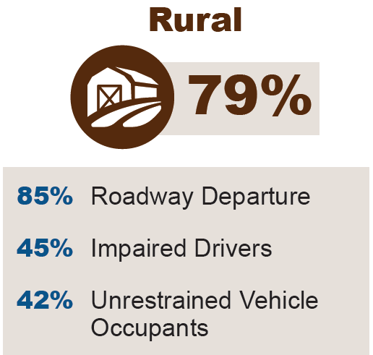
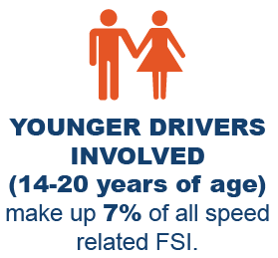
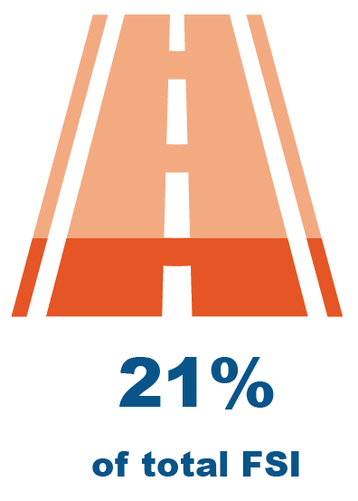
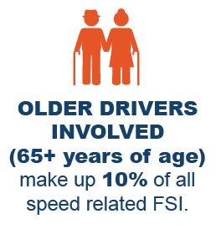
Speed Related Data Factsheet Key Takeaways
Safe Speeds & Safe Vehicles: Speed Related Data Factsheet Key Takeaways
Times of Week and Day to highlight:
  Late Afternoon - 15% (3:00pm-4:59pm)
  Saturdays – 19%
Source: MDT 2014-2023 Crash Data, February 2025 Extract (Persons)
*Data current as of February 2025 and subject to change with subsequent updates.

Slide 8
Erratic, Reckless, Negligent and/or Aggressive Driving Related Fatalities & Serious Injuries (FSI)
Safe Speeds & Safe Vehicles: Erratic, Reckless, Negligent and/or Aggressive Driving Related Fatalities & Serious Injuries
Involved in 24% of FSI
*MDT has defined erratic, reckless, negligent and/or aggressive driving as operating a vehicle with willful disregard for safety through behaviors like erratic lane changes, sudden speed variations, tailgating, cutting off others, or displaying extreme aggression toward other road users.
Source: MDT 2014-2023 Crash Data, February 2025 Extract (Persons)
*Data current as of February 2025 and subject to change with subsequent updates.
Notes:
Involved in:
21% of all crashes
24% of all FSI

Slide 9
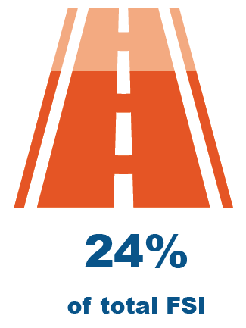
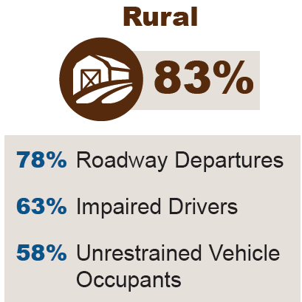

Erratic, Reckless, Negligent and/or Aggressive Driving Related Data Factsheet Key Takeaways
Safe Speeds & Safe Vehicles: Erratic, Reckless, Negligent and/or Aggressive Driving Related Data Factsheet Key Takeaways
Times of Week and Day to highlight:
  Late Afternoon - 15% (3:00pm-4:59pm)
  Saturdays – 19%
Source: MDT 2014-2023 Crash Data, February 2025 Extract (Persons)
*Data current as of February 2025 and subject to change with subsequent updates.

Slide 10
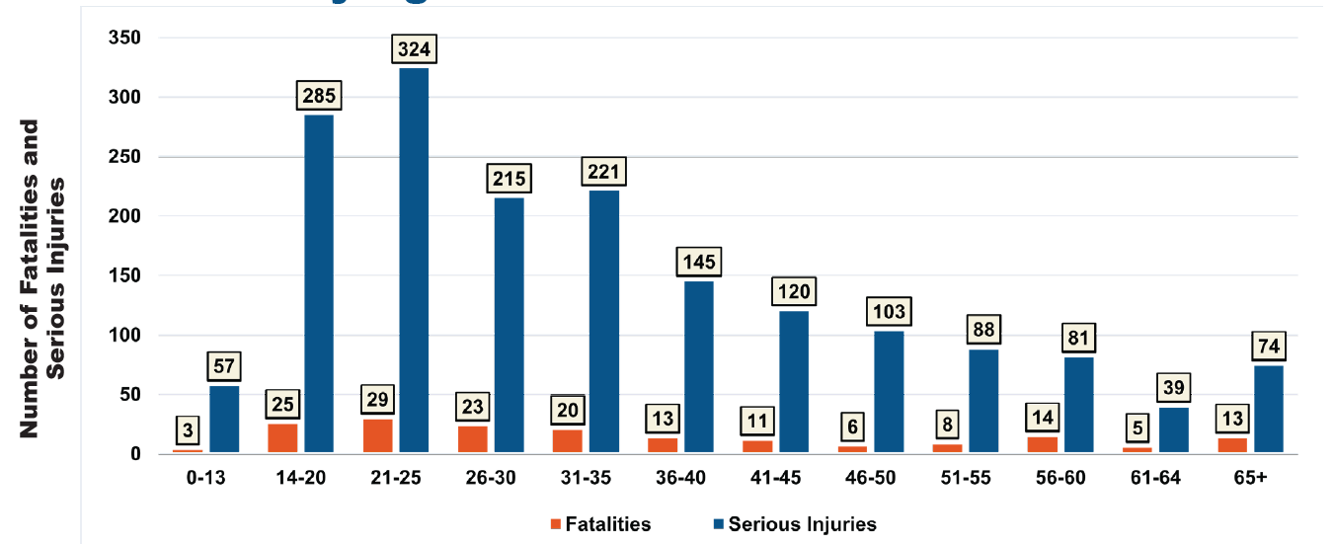
Erratic, Reckless, Negligent and/or Aggressive Driving Related Data Factsheet Key Takeaways
Safe Speeds & Safe Vehicles: Erratic, Reckless, Negligent and/or Aggressive Driving Related Data Factsheet Key Takeaways
14-25 year olds = 53% of all Fatalities and Serious Injuries
Source: MDT 2014-2023 Crash Data, February 2025 Extract (Persons)
*Data current as of February 2025 and subject to change with subsequent updates.

Slide 11
Large Vehicle Related Fatalities &
Serious Injuries (FSI)
Safe Speeds & Safe Vehicles: Large Vehicle Related Fatalities & Serious Injuries
Involved in 9% of FSI
*MDT has defined large vehicles as all heavy trucks 10,000 + pounds, and busses. (i.e. a van, bus, large truck, motor home, ambulance, fire truck, tow truck, farm vehicle, or construction vehicle).
Source: MDT 2014-2023 Crash Data, February 2025 Extract (Persons)
*Data current as of February 2025 and subject to change with subsequent updates.
Notes:
Involved in:
12% of all crashes
9% of all FSI

Slide 12


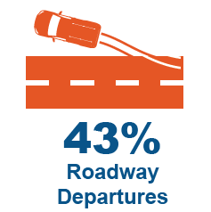
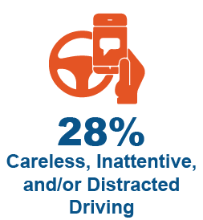
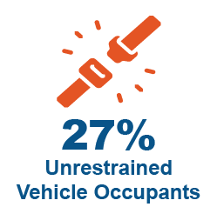

Large Vehicle Involved Data Factsheet Key Takeaways
Safe Speeds & Safe Vehicles: Large Vehicle Related Data Factsheet Key Takeaways
Leading Factors of Large Vehicle Involved Fatal and Serious Injuries:
*Leading factors shown represent all large vehicle involved fatalities and serious injuries, not exclusively factors attributed to large vehicle drivers. Data includes contributing factors from all parties involved in crashes with large vehicles.
Source: MDT 2014-2023 Crash Data, February 2025 Extract (Persons)
*Data current as of February 2025 and subject to change with subsequent updates.

Slide 13
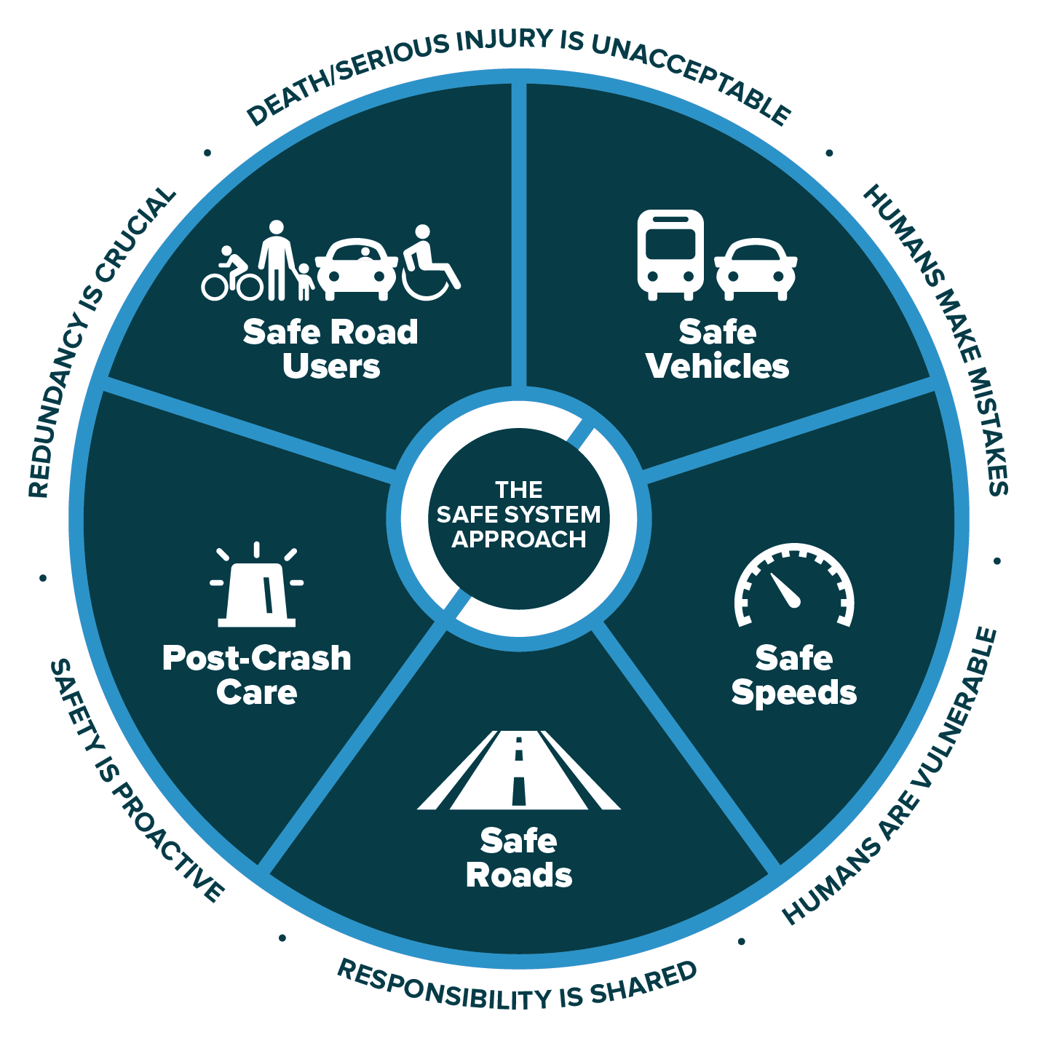
Applying the Safe System Approach
Applying the Safe System Approach to Safe Speeds / Safe Vehicles
How does SSA apply to this emphasis area?
Speed Related
Large Vehicle
Erratic/Reckless/
Negligent/Aggressive
Emerging Technologies

Slide 14
Safe Speeds / Safe Vehicles – 2020 Strategies
2020 CHSP Strategies – Safe Speeds & Safe Vehicles
Not an Emphasis Area in the 2020 CHSP

Slide 15
National Strategies for Safe Speeds
2020 CHSP Strategies – National Strategies for Safe Speeds
Implement a robust speed management program.
Improve information available for speed limit setting.
Provide noteworthy practices on re-engineering roads to slow down vehicles.
Develop education materials about speed safety cameras as Proven Safety Countermeasure.
Notes:
*Please keep in mind that we need to think outside the box on “speed management plan”. The lead may be law enforcement. Document the response from Gabe and Tricia and follow-up if necessary. The challenges to implementation need to be documented and included in CHSP. The challenges need to include laws and reference Montana Code Annotated.

Slide 16
National Strategies for Safe Vehicles
2020 CHSP Strategies – National Strategies for Safe Vehicles
Encourage the adoption of advanced driver-assistance systems (ADAS) in commercial vehicles, such as automatic emergency braking, lane departure warning, and adaptive cruise control.
Enforce strong maintenance standards for commercial vehicles related to safety equipment, such as brakes and tires being in good working order.
Notes:
“ For maintenance #2, a potential performance measure would be (Increase the number of CVSA inspectors / inspections).” Motor Carrier Services conducts CVSAs. I would pose that potential performance measure to Motor Carriers in attendance. Both divisions are housed within MDT. We need to find the hooks and get Maintenance more involved.

Slide 17
National Strategies for Safe Vehicles (Continued)
2020 CHSP Strategies – National Strategies for Safe Vehicles
3. Increase safety refresher and continued educational
course training for maintenance staff.
4. Develop education materials about motor
vehicle safety standards that save lives, such as:
    Automatic emergency braking
    Pedestrian automatic emergency braking
    Impaired driving detection
    Distracted driving detection
    Drowsy driving detection
    Rear impact guards on newly manufactured
    semi trailers
Notes:
“ For maintenance #2, a potential performance measure would be (Increase the number of CVSA inspectors / inspections).” Motor Carrier Services conducts CVSAs. I would pose that potential performance measure to Motor Carriers in attendance. Both divisions are housed within MDT. We need to find the hooks and get Maintenance more involved.

Slide 18
Safe Speeds/Safe Vehicles Strategies Discussion
Safe Speeds & Safe Vehicles Strategies Discussion
Open Discussion
  What are the best practices and safety countermeasures being implemented?
  What potential strategies should Montana consider?
  What concerns and/or questions do we have regarding these strategies?
Speed Related
Large Vehicle
Erratic/Reckless/
Negligent/Aggressive
Emerging Technologies
Notes:
Safe Roads = 85% of total FSI.
Emergency Response – Post-Crash Care = 77% of total FSI.
Safe Speeds/ Safe Vehicles = 46% of total FSI.
Safe Road Users = 71% of total FSI.
The percentages above may not sum up to the yearly total for the FSI. This discrepancy results from overlaps among existing sub-emphasis areas within each primary emphasis area. Participants will not find this information above in the packet (with the exception of Emergency Response)“ We want to share with you that when we conducted analysis of the related crash factors that are included within the emphasis area, our assessment showed that 46% of total FSI could be mitigated through Safe Speeds/Safe Vehicles’ proven safety countermeasures.
Open Discussion about Safe Speeds and Safe Vehicles Strategies

